Slide 1
Breast Cancer Prediction
Building: 1) A Classifier Model
2) A Regression Model
Candidate Name: Gaurav Parihar

Slide 2
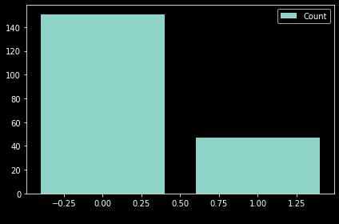
Algorithm(Steps)
Importing the initial useful library(pandas )
Importing Dataset
Creating Feature Matrices
Labelling of Data(Dependent as it is a string)
Checking out the missing values if any and if found filling it with the mean of the values of its respective column.
Checking the count of dependent data(‘N’ and ’R’)

Slide 3
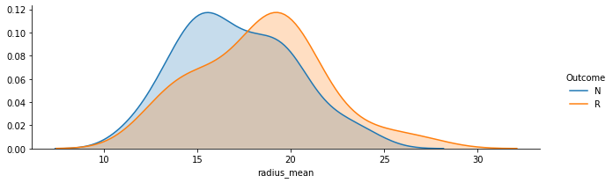
Continued….
7. Observing the Impact of Mean, Standard Deviation and Worst over the Outcome over various cell features(radius, texture, perimeter, area, smoothness, compactness, concavity, concave points, symmetry, and fractal dimension.)

Slide 4
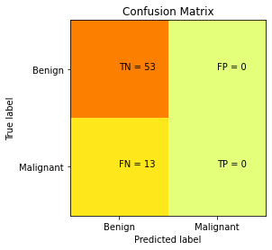
Continued….
8. Comparing Correlation between features.
9. Splitting of dataset into Training and Test.
10. Applying classifier(SVM classifier)
11. Achieved an accuracy of 80%

Slide 5
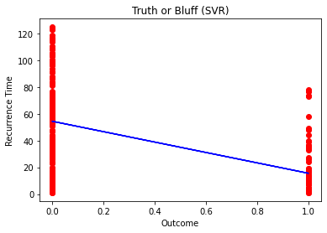
Regression Model(Steps)
Identification of regression model
Applied R^2 Test and found positive values of R^2 with SVM regression model.

